Slide 1
Positive Psychology
The Science of Human Strengths

Slide 2
Subject Code | 16B1NHS432 | Semester: ODD | Semester V Session 2022-23 Month from August 2022 to December 2022
Subject Name | POSITIVE PSYCHOLOGY
Credits | 3 | Contact Hours | 3-0-0

Slide 3
COURSE OUTCOMES |  | COGNITIVE LEVELS
CO1 | Demonstrate an understanding of the various perspectives of positive psychology and apply them in day to day life | Apply Level (C3)
CO2 | Examine various theories and models of happiness, well-being and mental health | Analyze Level (C4)
CO3 | Recommend possible solutions for enhancing happiness, well-being and mental health | Evaluating Level (C5)
CO4 | Evaluate interventions/strategies for overall positive functioning | Evaluating Level (C5)

Slide 4
Module No. | Subtitle of the Module | Topics in the module | No. of Lectures for the module
1. | Introduction to Positive Psychology | Overview, Perspectives, Classification and Measures: Human Strengths and Positive Outcomes. | 6
2. | Prosocial Behavior | Empathy and Egotism; Altruism, Gratitude, and Forgiveness. | 6
3. | Positive Emotions and Wellbeing | Emotional and Cognitive States; Focus on Application: Finding the positive in the Negative; Positive Emotions & Well-Being; Positive Emotions & Flourishing; Flow Experiences | 6

Slide 5
4 | Happiness | Happiness and its Traditions; Determinants- Subjective Well-Being Hedonic Basis of Happiness; Life Satisfaction; Self –Realization: The Eudaimonic Basis of Happiness Happiness and Emotional Experiences; Other Facts of Life- Work & Unemployment; Intelligence; Education; and Religion. | 6
5. | Mental Health | Mental Health and Behavior; Prevent the Bad and Enhance the Good. | 6

Slide 6
6. | Positive Environments | Positive Schooling, Good at Work, Balance Between ME and WE. | 6
7. | Living Well | Mindfulness; Contours of a Positive Life: Meaning & Means; Cultural Context, Every Stage of Life, Resilience, Positive Youth Development, Life Tasks of Adulthood, Successful Aging. | 6
Total number of Lectures |  |  | 42

Slide 7
Evaluation Criteria
Components Maximum Marks
T1 20
T2 20
End Semester Examination 35
TA 25 (Project, Assignment, Oral Questions, Attendance)
Total 100

Slide 8
Recommended Reading material: Author(s), Title, Edition, Publisher, Year of Publication etc. ( Text books, Reference Books, Journals, Reports, Websites etc. in the IEEE format)
Snyder, C.R., Lopez, S. J., & Pedrotti, J.T. Positive Psychology: The Scientific and Practical Explorations of Human Strengths, 4th Ed., Sage Publications, 2018.
Steve, B., & Marie, C. Positive psychology, 1st Ed., Pearson Education India, 2014.
Boniwell, I., & Tunariu, A. D., Positive Psychology: Theory, Research and Applications, 2nd Ed., McGraw-Hill Education, 2019.
Zelenski, J., Positive Psychology: The Science of Well-being, 1st Ed., Sage Publications, 2019.
Snyder, C. R., Lopez, S. J., Edwards, L. M., & Marques, S. C. (Eds.), The Oxford handbook of positive psychology. 1st Ed., Oxford university press, 2020.

Slide 9
Positive Psych’s “Official” Beginning
Father of Positive Psychology
Martin Seligman 1998 APA Presidential address
Proposed shift in focus for all of psychology:
” Positive Psychology”
FROM: studying and trying to undo the worst things in life
TO: studying and trying to build the best things in life
Asked: Why not study courage , joy, hope, happiness instead of just anxiety, violence, addiction, pathology, conformity, prejudice?

Slide 10
I. Why A Positive Psychology? Inside Factors
Balance:
A. General Psychology: Restoring balance to psychology’s historic emphasis on the negative. Add study of positives.
Overcome negative image of human nature.
- What learned about human nature in general psychology?
Neutral to negative – classical conditioning, disease model

Slide 11
B. Clinical Psychology: Providing language of mental health and human strengths to complement and complete language of mental illness and disease model.
Traditional Psych. - Disease Model - DSM - what’s wrong.
Positive Psych. - Strengths Model - Positive mental health - what’s right.
Traditional Psych. - life below zero.
Positive Psych. - What is life above zero?
Absence of illness isn’t health.
DSM- Diagnostic & Statistical Manual of Mental Disorders

Slide 12
2. Completeness:
A. Restoring psychology’s original focus on the totality of human qualities and experiences, including those declared off-limits for “scientific” psychology.
- Bringing back “forbidden” topics, e.g., virtue, religion.
B. “Good Life” - life well-lived.
- Know about a bad life - what is a good life?
- Provide answers to “deathbed test.”
- I wish I had devoted more of my life to________.
- What matters most in life?
- Medical science defined healthy lifestyle - markers of health.
- Psychological science - definitions & markers of health & flourishing?

Slide 13
Why has Psychology Historically Focused on the Negative and Not the Positives in Human Experience?
1. Disease Model & Being Useful:
Psychology’s historical desire to be useful, gain status, respect as a scientific discipline by solving problems.
Dominance of Disease Model - primacy of pathology as a focus.
World Wars.

Slide 14
2. Beliefs About Authenticity
Negatives states viewed as more real and authentic.
Cynical view - Freud - underneath veneer of civility and politeness lies nasty emotions and self-serving motives.
Psychology of motivation - self-serving biases, reinforcement, power, self-image protection, and promotion.
3. Beliefs About Positive Emotions
Joy, hope, optimism, happiness viewed as coping mechanisms to offset negative emotions. Not valuable in own right.
E.g., Offsetting stress versus cultivating positive emotions.

Slide 15
Why negative?
4. Power of Negative
Trait Negativity Bias -
Research:
- Impression formation gives more weight to negative information
- Relationships - One negative can undo thousand acts of kindness.
Presence or absence of negative, not positive, differentiates good from bad relationships.
Why negative given more weight & attention?
1.Violates general expectation of positivity in everyday life.
2. Evolutionary value of negative/threats over positive.

Slide 16
II. Factors Outside Psychology Why Now?
Why explosion in interest, books, articles, press coverage?
Psychology and the “Zeitgeist” of 1990s & early 2000s
- Measures of material well-being going north.
- Measures of subjective well-being going south.
- Levels of happiness flat despite dramatic gains in income/material possessions.
Paradox of Affluence - affluence and emotional well-being and
cultural malaise.
Affluent families & kids - The Lost Children of Rockdale County.
Too materialistic - Cushman “empty self.”
Too disconnected from communities & family. Putnam- Bowling Alone.

Slide 17
Depression - up despite increased affluence
Rates: higher than ever - “epidemic”
- Over last 40 years, twice as rich but 10 times more likely to be depressed - high rates among young, affluent, educated.
- 15-20% of Americans suffer bout with severe depression.
- 50% deal with milder forms.
- Women twice rates of men.
Onset:
Past - average age of onset in 30s.
Today - 14 to 15 years old…10th grade girls…40-%-50% -symptoms.
Other indicators:
Divorce rates doubled, teen suicide tripled, juvenile crime quadrupled.

Slide 18
III. Outside & Inside Current Culture Vs. Traditional Psychology
- Pop Psychology: Oprah & Dr. Phil
Millions looking for guidance & direction to find happy and meaningful life.
- What does psychology have to offer? - Mostly negative.
Diener: 17 studies of negative states to 1 of positive.
Seligman: last 30 years - 54,000 articles on depression, only 14 on joy.
2% of NIMH budget of 1 billion spent on human strengths.
19,00 articles on bias and error to 7,500 articles on strength and virtue.

Slide 19
Defining Positive Psychology
Orientation & Goals
1. Balance & Completeness
Restore balance to field of psychology…positives and negatives.
Just as important to know how most teens maintain health and happiness (majority) as to now why some get depressed, use drugs, etc.
2. Positive – life above zero
Psychology should be more than a bicycle repair shop for broken lives. Absence of misery not same thing as health or happiness.
3. Health & Strengths
What is life like on the other side of zero? Positive mental health.
Focus on positive: emotional health, strength, virtue, happiness, joy, satisfaction, etc.
Develop classification of positive mental health, strengths & virtues equivalent to DSM.

Slide 20
Definition Agenda
Seligman:
Positive Psych. - study of what makes life worth living:
1. The Pleasant Life: happiness - more positive than negative emotions.
2. The Engaged Life: active involvement, absorption in work, play, community, family, relationships.
3. The Meaningful Life: purpose, direction, personal expressiveness, religion, spirituality, nature, transcendent beliefs beyond self-interest.

Slide 21
What Is Positive Psychology?
The scientific and applied approach to uncovering people’s strengths and promoting their positive functioning.

Slide 22
Measuring a good life
Positive Psych. Research – good life measured by:
Happiness - life satisfaction, positive emotions.
Health - physical & emotional well-being & positive mental health.
Meaningfulness - purpose, transcendent , beyond self.
Virtue - “good” behavior - wisdom, forgiveness, courage.
DVs = 1-5 = good life
IVs = all aspects of our personal qualities & life circumstances that contribute to 1-5.
Baumgardner/Crothers definition:
Positive psychology is the scientific study of the individual traits, life goals, circumstances, and social conditions that contribute to a happy, a meaningful, a virtuous, and a healthy life, defined by flexible criteria that allow for individual and cultural differences in the particular features and meanings of a life well-lived.

Slide 23
Power of the Positive
The Nun Study - Danner, Snowdon, & Friesen
Prior Research:
- Emotions, health & immune system
- Genetics & temperament - Labrador effect
- Temperament, + & - emotions, coping
- Writing about significant life events - outlook
Hypothesis: Cheerful people shown in autobiographical sketches will live longer than sourpusses.
Sample: 180 nuns - 1930s (ideal sample)
IV: Emotions shown in autobiographical statements
DV: Mortality & longevity

Slide 24
Results:
Compare upper 25% to lowest 25% in expressions of positive emotion in words & sentences.
- 90% of most cheerful nuns alive at 85 yrs. of age.
- Only 34% of least cheerful alive at 85.
- 54% of most cheerful still going at 94 yrs.
- Only 11% of least cheerful.
“Early” deaths in 50s & 60s mostly least cheerful.

Slide 25
One Final Issue - Myers
Does it make sense to study happiness and health when the world is full of much misery?
Isn’t happiness a self-focused, self-absorbed, and selfish state that has no enduring value beyond the pleasure of the individual?
What are people like when they are happy & content versus when unhappy or depressed?
When we’re happy are we more likely to be:
Self or other focused?
Selfish or compassionate?
Unhelpful or helpful to others?
Hold a grudge or forgive?
Intolerant or tolerant?
Unkind or kind to others?
Research conclusions.

Slide 26
Positive Psychology: History and Context within Psychology
I. History - the “positive” in psychology.
Drawing together positive research and theory.
-1. Quality of Life Surveys - subjective well-being.
Objective circumstances don’t matter much:
10-15%.
-2. Humanistic psychology (theory, no data).
Actualizing inner potentials - moving up need hierarchy.
Optimal functioning - peak experiences - personally expressive life.
Current theory & research picked up humanistic ideas.

Slide 27
-3. Clinical Psychology
Disillusionment with disease model - prevention of illness & promotion of public mental health.
Curing illness not same as enhancing health.
PTSD* versus PTG** - over “therapizing.”
*Post traumatic stress disorder
** Post traumatic growth
-4. Developmental & Lifespan Psychology
Amazing resilience/strength among children, teens, adults, and elderly in face of major life traumas and changes. Normal or enhanced functioning in face of threats.
Successful Aging - most elderly not depressed, or in ill-health.
Socio-emotional Selectivity Theory - positive spin to previous negative interpretations of change.

Slide 28
-5. Health Psychology
Mind-body connections, power of positive beliefs & emotions.
Hope, optimism and will show “real” effects.
Social support from others.
-6. Social/Personality Psychology & Psych. of Religion
Relationships, health, and happiness.
Self-esteem, positive view of self, positive illusions.
Critiques of materialistic beliefs and values.

Slide 29
Eastern and Western Perspectives on Positive Psychology

Slide 30
The ME/WE Balance
ME = individualism = pursuit of a sense of specialness relative to others
WE = collectivism = trying to maximize one’s link to others
ME = focus on one
WE = focus on the many
WE/ME = US

Slide 31
The Psychology of ME: Individualism
U.S. = Land of the Rugged Individualist
Anyone who works hard can achieve
Equal rights and freedom
Me generation

Slide 32
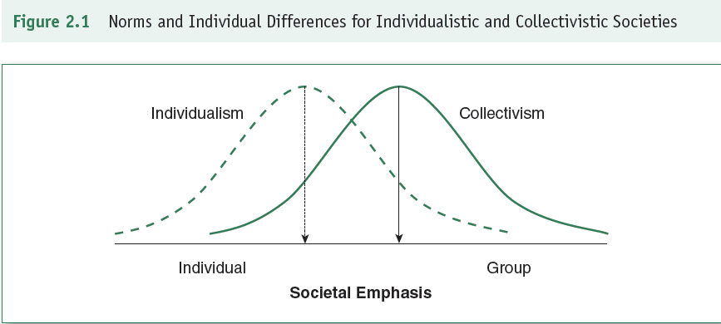
The Psychology of ME and WE

Slide 33
The Psychology of ME: Individualism
Summary:
- Independence
- Uniqueness
- Self as the unit of analysis

Slide 34
Uniqueness Attributes
Each society has acceptable attributes whereby its citizens can show their differences:
- commodities/possessions
- names
- attitudes and beliefs
- performances

Slide 35
The Psychology of WE: Collectivism
Hunter-gatherer ancestors
Power of groups:
contribute to a sense of belonging
foster personal identities and roles
offer shared emotional bonds
help fend off threats

Slide 36
ME/WE Balance
Polarity not good science or productive
Research = while Americans are higher in individualism, they are not necessarily lower in collectivism

Slide 37
ME/WE Balance
Polarity leads to disputes
Move beyond static view:
- embrace aspects of each
- attend to both the person & the group

Slide 38
ME/WE Balance
To find Balance:
Suggestions for WE people (collectivists)
Suggestions for ME people (individualists)

Slide 39
ME/WE Balance
Individualistic views are not widely shared around the world
70% of the world is collectivistic
4.5 billion collectivists; 2 billion individualists

Slide 40
Classifications and Measures of Strengths and Positive Outcomes

Slide 41
Classifications of Illness and Strengths
“Strength” defined as: capacity for feeling, thinking, and behaving in a way that allows optimal functioning in the pursuit of valued outcomes (Linley & Harrington, 2006).
Long way to go in figuring out how to measure strengths

Slide 42
Classifications of Illness
2 Classifications Accepted World-Wide:
1. International Classifications of Diseases (ICD) by the World Health Organization
2. Diagnostic & Statistical Manual of Mental Disorders (DSM) by the American Psychiatric Association

Slide 43
Classifications of Strengths
No Classifications Accepted World-Wide, yet!
3 Models In Use by Many:
1. Gallup Themes of Talent via Clifton StrengthsFinder.
2. Values in Action Classification of Strengths
3. Search Institute’s 40 Developmental Assets

Slide 44
Gallup’s Clifton StrengthsFinder
“What would happen if we studied what was right with people” - Donald Clifton, CEO Gallup
Talent can be operationalized, studied, and accentuated in work and academic settings
Strengths are extensions of talent:
Strength = talent + related knowledge + related skills

Slide 45
StrengthsFinder 2.0
measures 34 Talent Themes
on-line measure for adolescents and adults
released in 2007
psychometrically sound (valid and reliable)
available in 17 languages

Slide 46
Clifton Youth StrengthsExplorer
measures 10 Talent Themes (signature themes)
on-line measure for children & youth (10 - 14 years old)
released in 2006
comes with a Youth Workbook and Parent & Educator Guides

Slide 47
Gallup’s Clifton Strengths Finder
Clifton studied success across a wide variety of business and education domains.
He bases his analysis of success on a simple question: ‘ WHAT WOULD HAPPEN IF WE STUDIED WHAT IS RIGHT WITH PEOPLE?
Clifton believed that talents could be operationalized, studied and accentuated in work and academic settings.
He defined talent as “ naturally recurring patterns of thought, feeling or behavior that can be productively applied”.( Hodges & Clifton, 2004)
Clifton viewed strengths as extensions of talent. More precisely, the strength construct combines talent with associated knowledge and skills and is defined as the ability to provide consistent, near-perfect performance in a specific task.
Clifton considered success to be closely allied with personal talents, strengths and analytical intelligence

Slide 48
Gallup’s Clifton 34 Strengths Finder Themes
Achiever Discipline Responsibility
Activator Empathy Restorative
Adaptability Focus Self-assurance
Analytical Futuristic Significance
Arranger Harmony Strategic
Belief Ideation WOO(Winning others over)
Command Includer
Communication Individualization
Competition Input
Connectedness Intellection
Consistency Learner
Context Maximizer
Deliberative Positivity
Developer Relator

Slide 49
Values in Action Classification of Strengths
Developed by Peterson & Seligman (2004)
Antithesis of the DSM
Provides a common language for strengths
24 Strengths that meet 10 Criteria
Based upon 6 Virtues

Slide 50
Values in Action Inventory of Strengths (VIA-IS)
measures 24 character strengths
on-line and paper-and-pencil measure for adults
psychometrically sound (valid and reliable)
sensitive to change over time

Slide 51
Values in Action Inventory of Strengths for Youth (VIA-Youth)
measures 24 character strengths
on-line measure for adolescents
adequate psychometric properties

Slide 52
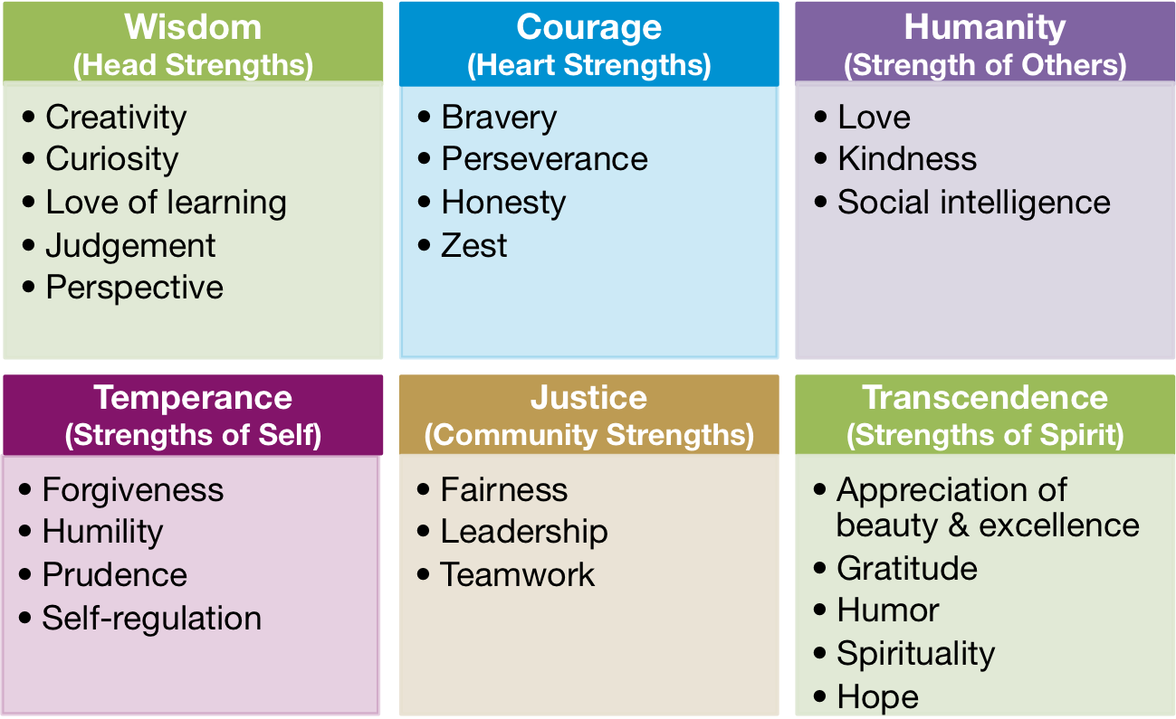

Slide 53
The Values in Action (VIA) Classification of Virtues (6) & Strengths (24 Strengths)
Wisdom: Cognitive strengths that entail the acquisition and use of knowledge
Courage: Emotional strengths that involve the exercise of will to accomplish goals in the face of opposition, external and internal
Humanity: Interpersonal strengths that involve tending and befriending others
Justice: Civic strengths that underlie healthy community life
Temperance: Strengths that protect against excess
Transcendence: strengths that forge connections to the larger universe and provide meaning

Slide 54
Wisdom
Creativity: conceptualizing something useful, coming up with ideas that result in something worthwhile
Curiosity: seek out situations where I gain new experiences without getting in my own or other people’s way
Judgment: weigh all aspects objectively in making decisions, including arguments that are in conflict with my convictions
Love of learning: motivated to acquire new levels of knowledge, or deepen my existing knowledge or skills in a significant way
Perspective: give advice to others by considering different (and relevant) perspectives and using my own experiences and knowledge to clarify the big picture

Slide 55
Courage
Bravery: acting on one’s convictions, and facing threats, challenges, difficulties, and pains, despite doubts and fears.
Honesty: honest to oneself and to others, trying to present oneself and one’s reactions accurately to each person, and taking responsibility for actions.
Perseverance: persisting toward goals despite obstacles, discouragements, or disappointments.
Zest: feeling vital and full of energy, and approaching life feeling activated and enthusiastic."

Slide 56
Humanity
Kindness: helpful and empathic and regularly do nice favors for others without expecting anything in return.
Love: experience close, loving relationships that are characterized by giving and receiving love, warmth, and caring.
Social Intelligence: Being aware of and understand feelings and thoughts of oneself, as well as the feelings of those around me."

Slide 57
Justice
Fairness: treating everyone equally and fairly, and give everyone the same chance applying the same rules to everyone.
Leadership: Taking charge and guiding groups to meaningful goals, and ensure good relations among group members
Teamwork: Being helpful and contributing to group and team member, and feel responsible for helping the team reach its goals.

Slide 58
Temperance
Forgiveness: forgiving others when they upset and/or when they behave badly, and using that information in future relations with them.
Humility: Seeing my strengths and talents but being humble, not seeking to be the center of attention or to receive recognition.
Prudence: Acting carefully and cautiously, looking to avoid unnecessary risks and planning with the future in mind.
Self-Regulation: Managing feelings and actions and being disciplined and self-controlled.

Slide 59
Transcendence
Appreciation of Beauty & Excellence: Recognizing, emotionally experience, and appreciate the beauty around oneself and the skill of others.
Gratitude: Being grateful for many things and expressing thankfulness to others.
Hope: Being realistic and also full of optimism about the future, believing in actions and feeling confident that things will turn out well.
Humor: Approaching life playfully, making others laugh, and finding humor in difficult and stressful times.
Spirituality: Feeling spiritual and believe in a sense of purpose or meaning in life; and I see one’s place in the grand scheme of the universe and find meaning in everyday life.

Slide 60
The Search Institute’s Developmental Assets
“What protects children from today’s problems?”
Internal and external variables that contribute to a child’s thriving.
40 Developmental Assets that lead to thriving:
20 External
20 Internal
External assets are the positive experiences that children and youth gain through interactions with people and institutions.
Internal assets are those personal characteristics and behaviors that stimulate the positive development of young people.

Slide 61
Search Institute Profiles of Student Life: Attitudes and Behaviors
156-item survey
for use with children and youth
describes:
40 developmental assets
8 thriving indicators
Psychometrics are unknown

Slide 62
Search Institute Profiles of Student Life: Attitudes and Behaviors
8 thriving indicators
External Assets
Support
Empowerment
Boundaries and Expectations
Constructive Use of Time
Internal Assets
Commitment to Learning
Positive Values
Social Competencies
Positive Identity

Slide 63
Support:
1. Family support—family life provides high levels of love and support
2. Positive family communication—young person and her or his parent(s) communicate positively, and young person is willing to seek advice and counsel from parents
3. Other adult relationships—young person receives support from three or more non-parent adults
4. Caring neighbourhood—young person experiences caring neighbours
5. Caring school climate—school provides a caring, encouraging environment
6. Parent involvement in schooling—parent(s) are actively involved in helping young person succeed in school

Slide 64
Empowerment:
7. Community values youth—young person perceives that adults in the community value youth
8. Youth as resources—young people are given useful roles in the community
9. Service to others—young person serves in the community one hour or more per week
10. Safety—young person feels safe at home, at school, and in the neighbourhood

Slide 65
Boundaries and expectations:
11. Family boundaries—family has clear rules and consequences and monitors the young person’s whereabouts
12. School boundaries—school provides clear rules and consequences
13. Neighbourhood boundaries—neighbours take responsibility for monitoring young people’s behaviour
14. Adult role models—parent(s) and other adults model positive, responsible behaviour
15. Positive peer influence—young person’s best friends model responsible behaviour
16. High expectations—both parent(s) and teachers encourage the young person to do well

Slide 66
Constructive use of time:
17. Creative activities—young person spends three or more hours per week in lessons or practice in music, theater, or other arts
18. Youth programs—young person spends three or more hours per week in sports, clubs, or organizations at school and/or in the community
19. Religious community—young person spends one or more hours per week in activities in a religious institution
20. Time at home—young person is out with friends ‘‘with nothing special to do’’ two or fewer nights per week

Slide 67
Commitment to learning:
21. Achievement motivation—young person is motivated to do well in school
22. School engagement—young person is actively engaged in learning
23. Homework—young person reports doing at least one hour of homework every school day
24. Bonding to school—young person cares about her or his school
25. Reading for pleasure—young person reads for pleasure three or more hours per week

Slide 68
Positive Values:
26. Caring—young person places high value on helping other people
27. Equality and social justice—young person places high value on promoting equality and reducing hunger and poverty
28. Integrity—young person acts on convictions and stands up for her or his beliefs
29. Honesty—young person ‘‘tells the truth even when it is not easy’’
30. Responsibility—young person accepts and takes personal responsibility
31. Restraint—young person believes it is important not to be sexually active or to use alcohol or other drugs

Slide 69
Social competencies:
32. Planning and decision making—young person knows how to plan ahead and make choices
33. Interpersonal competence—young person has empathy, sensitivity, and friendship skills
34. Cultural competence—young person has knowledge of and comfort with people of different cultural/racial/ethnic backgrounds
35. Resistance skills—young person can resist negative peer pressure and dangerous situations
36. Peaceful conflict resolution—young person seeks to resolve conflict nonviolently

Slide 70
Positive identity:
37. Personal power—young person feels he or she has control over ‘‘things that happen to me’’
38. Self-esteem—young person reports having a high self-esteem
39. Sense of purpose—young person reports that ‘‘my life has a purpose’’
40. Positive view of personal future—young person is optimistic about her or his personal future

Slide 71
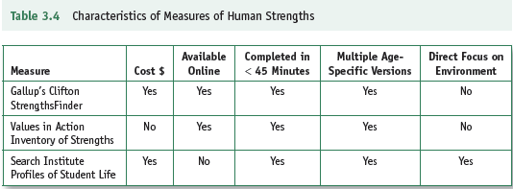
Comparisons of Measures of Strengths
All identify a person’s primary strengths
All were created within a Western framework

Slide 72
Positive Outcomes

Slide 73
Dimensions of Well-Being
Subjective Well-Being (aka Emotional Well-Being/Happiness) = individuals’ appraisals of their own lives capture the essence of well-being (Ed Deiner)
Objective Approaches =
Psychological Well-Being (Carol Ryff)
Social Well-Being (Corey Keyes)

Slide 74
Dimensions of Well-Being
Subjective/Emotional Well-Being +
Psychological Well-Being +
Social Well-Being =
Complete Portrayal of Mental Health

Slide 75
Favorable Outcomes, described by Ryff and Keyes
Self-acceptance
Personal growth
Purpose in life
Environmental mastery
Autonomy
Positive relations with others

Slide 76
Dimensions of Well-Being: Psychological
Self Acceptance: Possess positive attitude toward the self; acknowledge and accept multiple aspects of self; feel positive about past life
Personal Growth: Have feelings of continued development and potential and open to new experience; feel increasingly knowledgeable and effective
Purpose in Life: Have goals and a sense of direction in life; past life is meaningful; hold beliefs that give purpose to life

Slide 77
Dimensions of Well-Being: Psychological
Environmental Mastery: Feel competent and able to manage complex environment; choose or create personally suitable community
Autonomy: Are self-determining, independent and regulated internally; resist social pressures to think and act in certain ways; evaluate self by personal standards
Positive Relations with Others: Have warm, satisfying, trusting relationships; are concerned about other’s welfare; capable of strong empathy, affection and intimacy; understand give and take of relationships

Slide 78
Dimensions of Well-Being: Social
Social Acceptance: Have positive attitudes towards people; acknowledge others and generally accept people; despite others sometimes complex and perplexing behavior
Social Actualization: Care about and believe society is evolving positively; think society has potential to grow positively, think self/society is realizing potential
Social Contribution: Feel they have something valuable to give to the present and society; think their daily activities are valued by their community

Slide 79
Dimensions of Well-Being: Social
Social Integration: Feel part of community; think they belong, feel supported and share commonalities with community
Social Coherence: Social coherence involves appraisals that society is discernable, sensible and predictable.

Slide 80
Dimensions of Well-Being: Emotional
Positive Affect: Experience symptoms that suggest enthusiasm, joy and happiness for life
Negative Affect: experience at times that life is undesirable and unpleasant.
Life Satisfaction: a sense of contentment, peace and satisfaction from small discrepancies between wants and needs with accomplishments and attainments
Happiness: Having a general feeling and experience of pleasure, contentment and joy

Slide 81
Complete Mental Health
Flourishing
(Complete Mental Health)
Languishing
(Incomplete Mental Health)
High levels of:
emotional,
psychological, and
social well-being
(Keyes; pp. 60-62)
Low levels of:
emotional,
psychological, and
social well-being

Slide 82
Positive Outcomes (little dream about the future of Positive Psychology
Love: agape; spiritual love, selflessness
School and work: multicultural competence and more effective relationships
Play: developed social, emotional, and physical skills

Slide 83
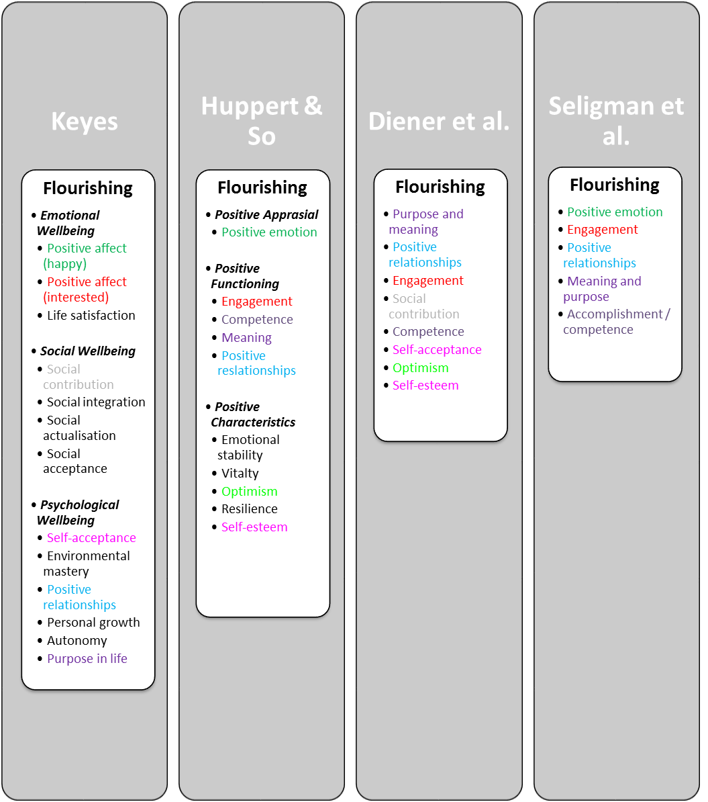
What is positive psychology?
Positive Education
Positive Health
Positive Assessment
Positive Psychotherapy
Positive Organisations

Slide 84
Q1. A basic premise of positive psychology is that the field of psychology
is out of balance with too much focus on negative human behaviors.
needs more effective methods for treating mental illness.
has not examined how every “negative” contains a “positive.”
has placed too much emphasis on genetic determinants, leaving little room for positive change.
Answer: A

Slide 85
Q2. The idea that the ”bad is stronger than the good” comes from research showing that
a single negative event can overwhelm a person’s coping defenses.
negative information and behaviors command more attention and have greater impact than positive ones.
it is only through negative life events that people develop the capacity for goodness and achieve health and happiness.
from the perspective of evolution, human nature is basically self centered and focused on self-perpetuation.
Answer: B

Slide 86
Q3. For positive psychologists, one problem with the disease model is that it
has diverted attention away from genetic causes of mental illness.
places too much emphasizes on biological causes and drugs as treatment.
has been largely ineffective in defining and treating mental illness.
implies that the mental health is the simply the absence of mental illness
Answer: D

Slide 87
Q4. The emergence of positive psychology in the late 1990s had much to do with cultural trends, or zeitgeist, captured in the phrase
tired of the negative.
the paradox of affluence.
the misery index.
money doesn’t buy happiness.
Answer: B

Slide 88
Q5. To achieve its goal of restoring balance to the discipline of psychology, positive psychology needs further development in research and theory focused on
positive behaviors and descriptions of positive mental health.
the positive side of negative behaviors.
the origins of negative behaviors.
how to overcome the negative effects of the disease model.
Answer: A

